Slide 1
FunShapes and FunBreathing
Using motion-based input in new and existing games to provide means of calming and exercise for people with autism, paralysis or cerebral palsy

Slide 2
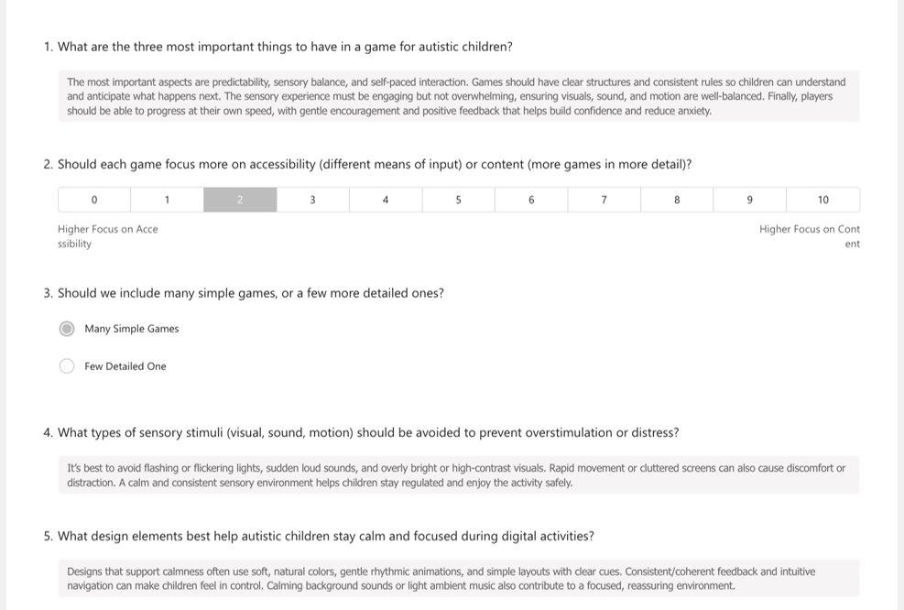
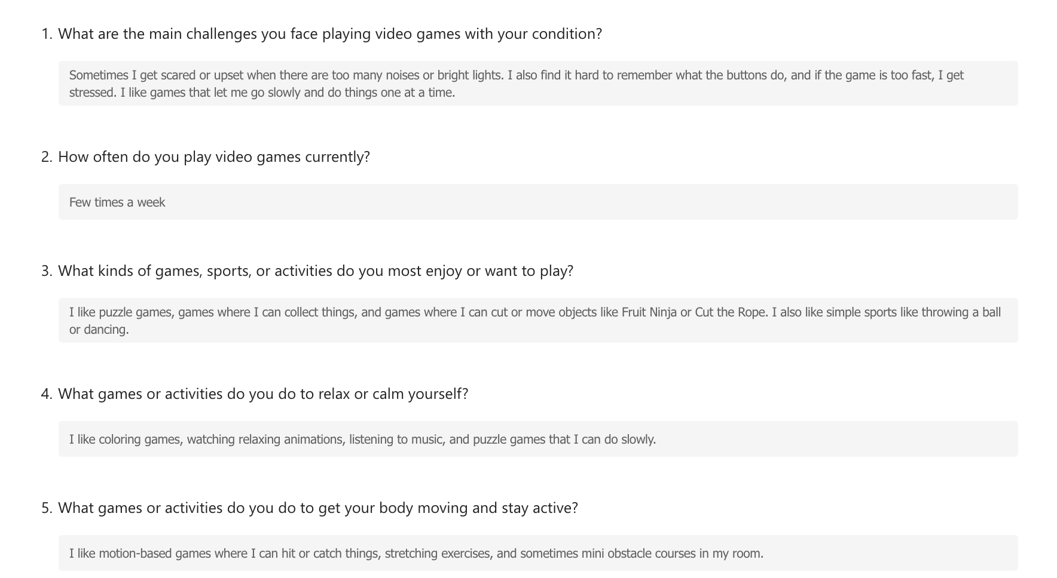
Establishing User Requirements
For user requirements, we delivered online forms to: a NAS representative; adults diagnosed with autism, paralysis and cerebral palsy; parents of children diagnosed with these conditions. Examples below:
From NAS Representative
From Adult with Autism

Slide 3
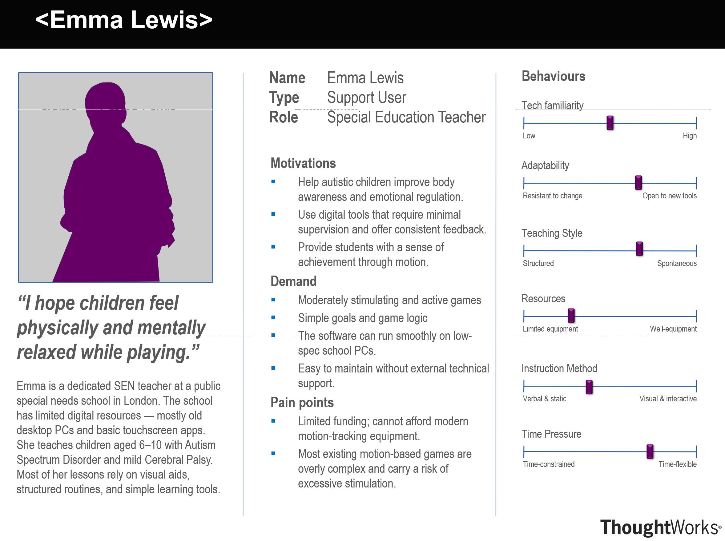
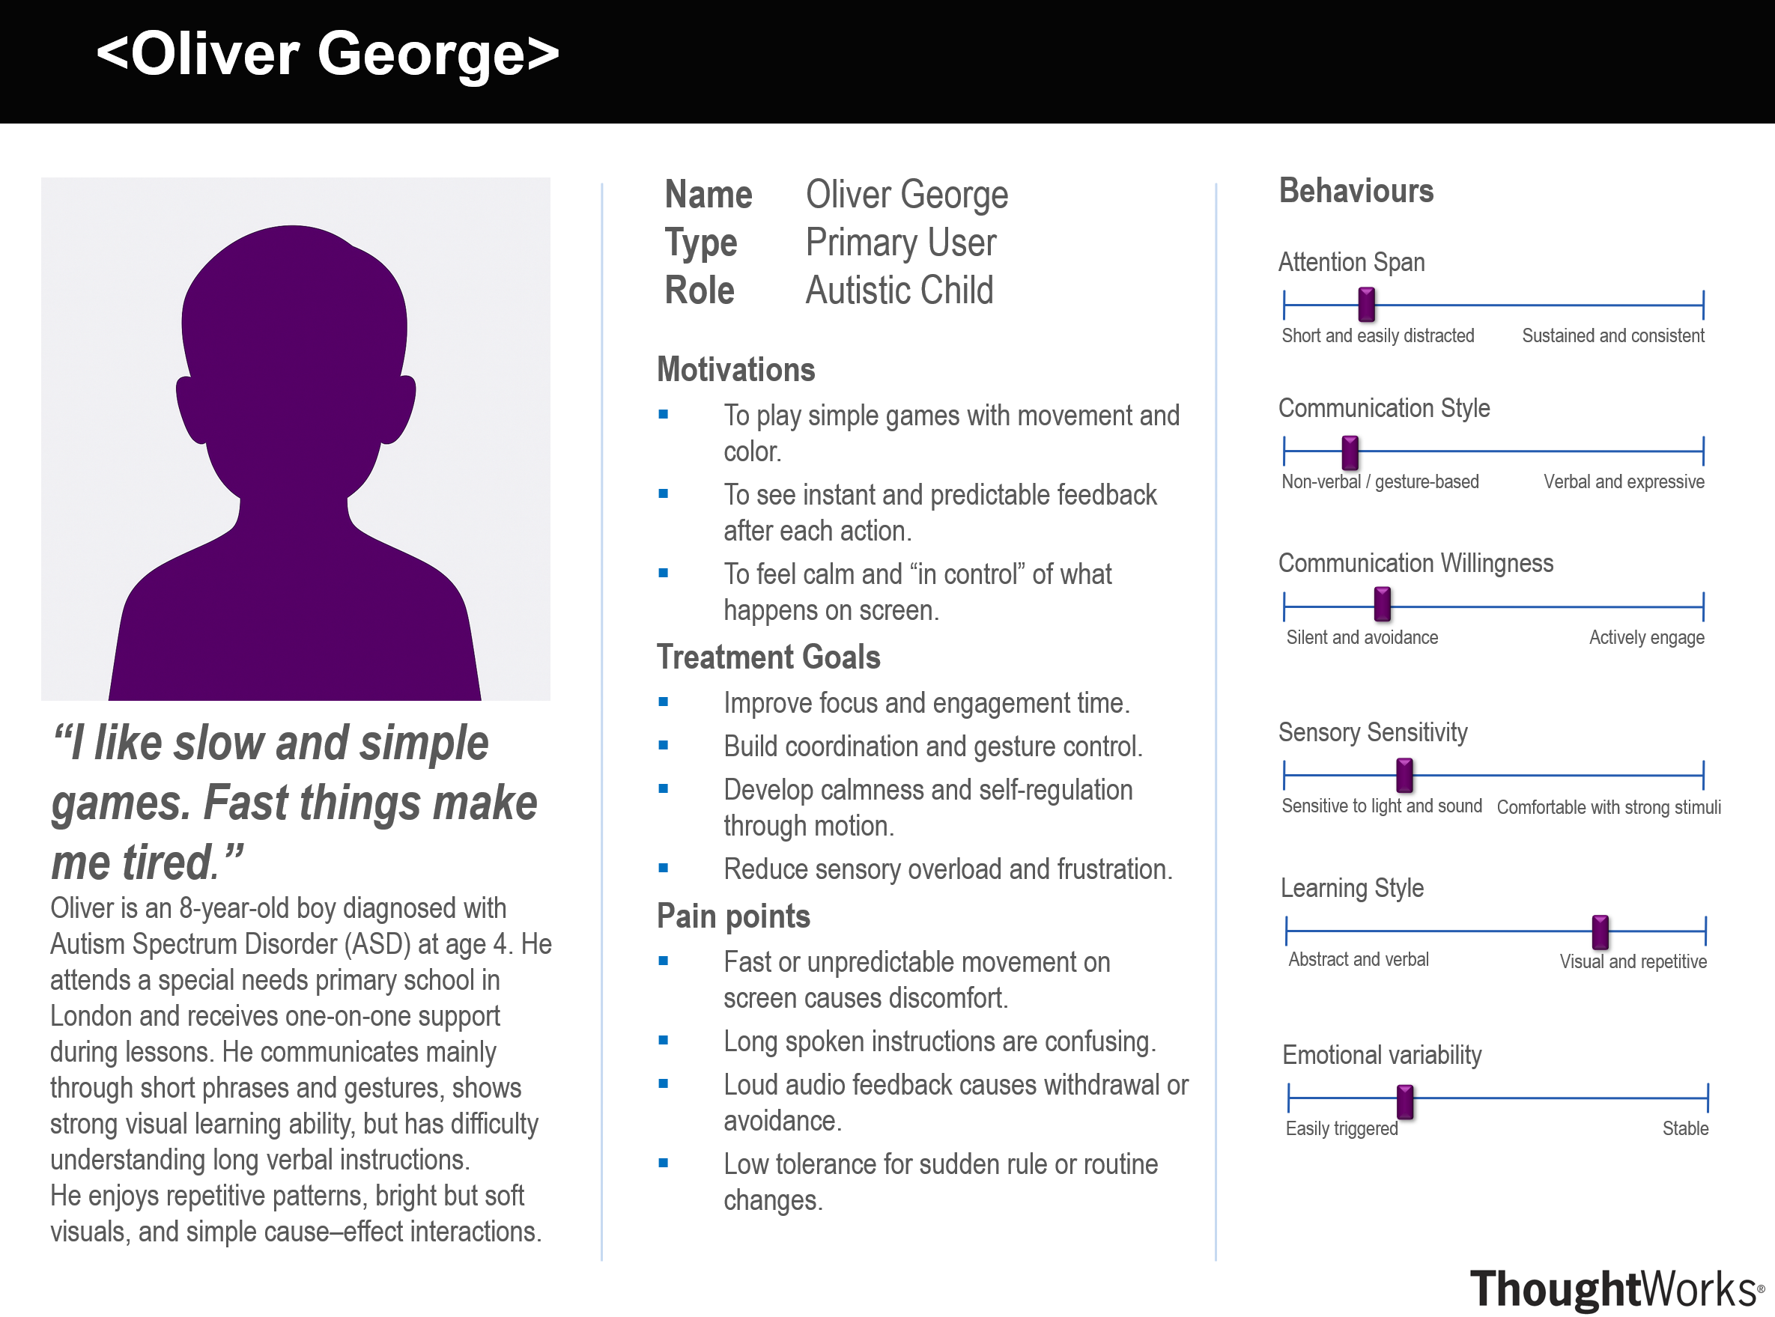
Personas
Information gathered from interviews
Scenarios
At the start of PE, Emma sets up FunBreathing for her students.
On the screen, a glowing flame responds to each student’s breathing.
As Emma gently guides them: “breathe slowly… and blow out the fire” - the room becomes quiet and focused.
Everyone calms down, watching the soft movement of the flame that changes with their breathing.
Emma feels relieved and proud: with simple technology, she can help her students stay active, focused, and calm.
During Oliver's classroom activity, his teacher starts FunShapes. The screen shows floating shapes in different colours.
Using his hand, Oliver points to a blue triangle - it lights up! He notices another blue triangle and moves his hand toward it.
The two shapes merge, a bell sound plays, and a progress bar rises.
Encouraged by the feedback, Oliver continues matching pairs of colourful shapes.
Each merge gives the same rewarding, predictable response.
By the end, Oliver completes the level and smiles when the screen displays “Well done.”
The game helps him stay calm, practice coordination, and experience success in a structured and sensory-friendly way.
* Due to no consent from the interviewees, we used silhouettes and pseudonyms to represent our users.

Slide 4
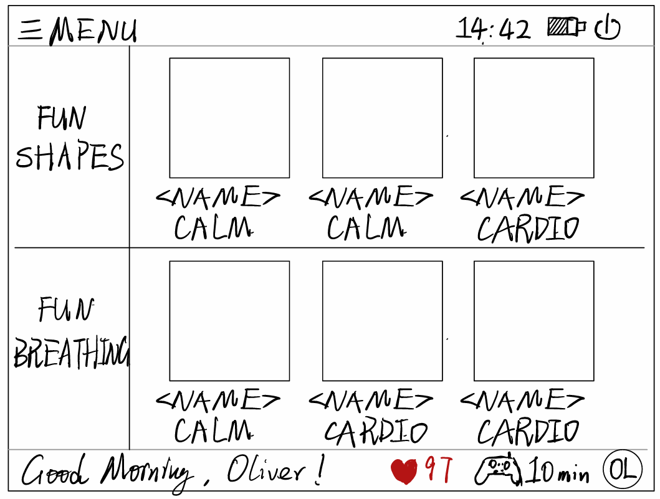
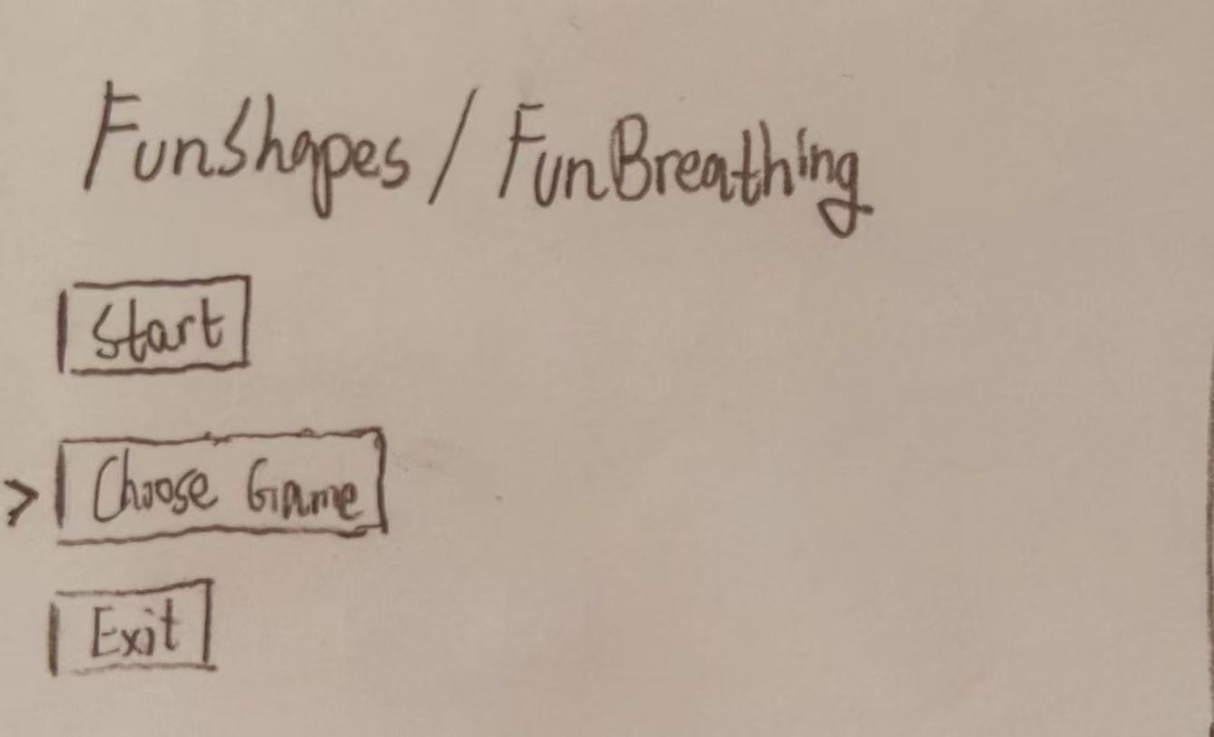
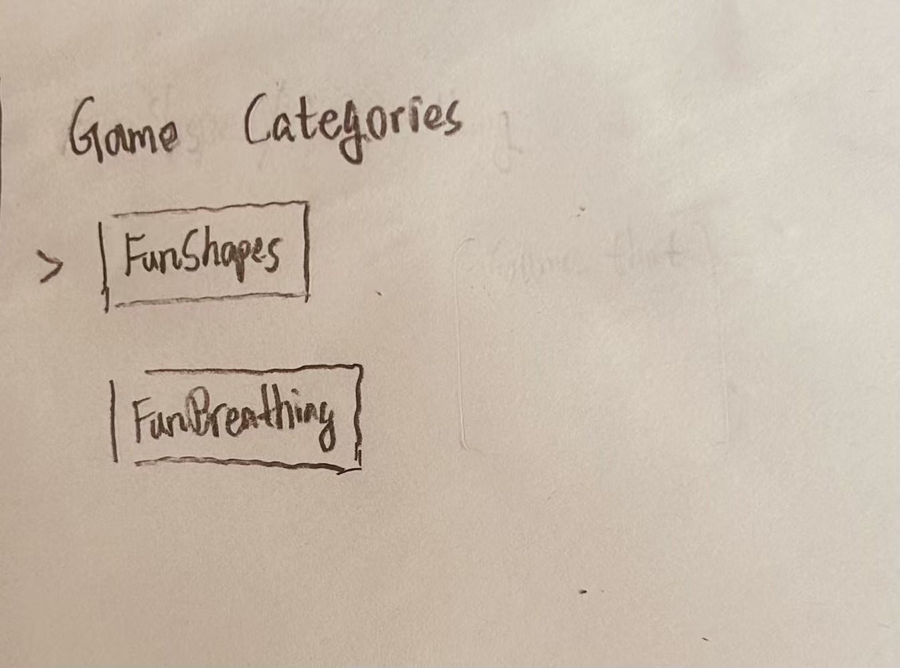
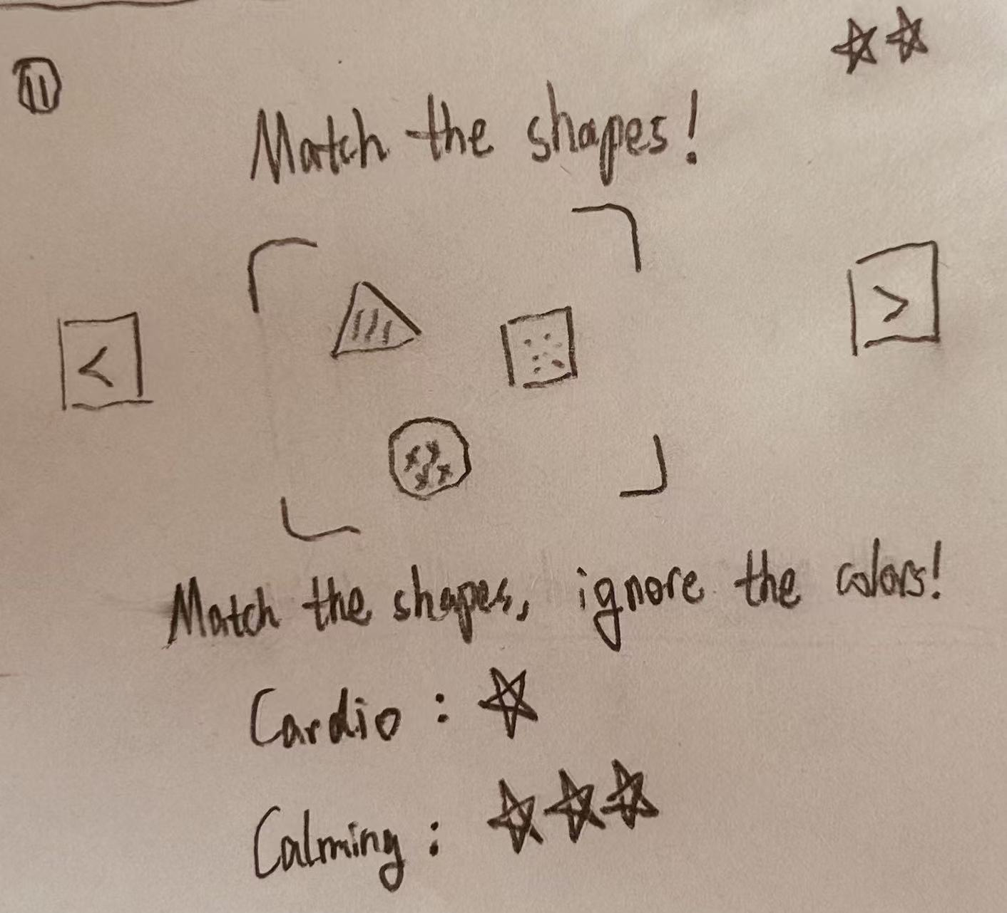
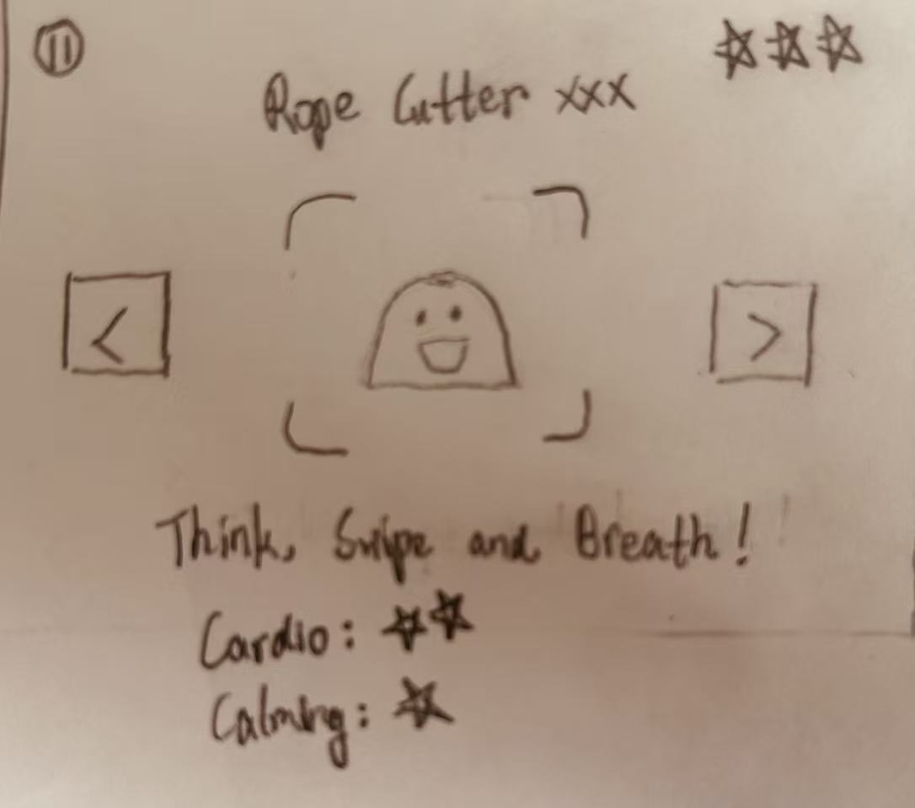
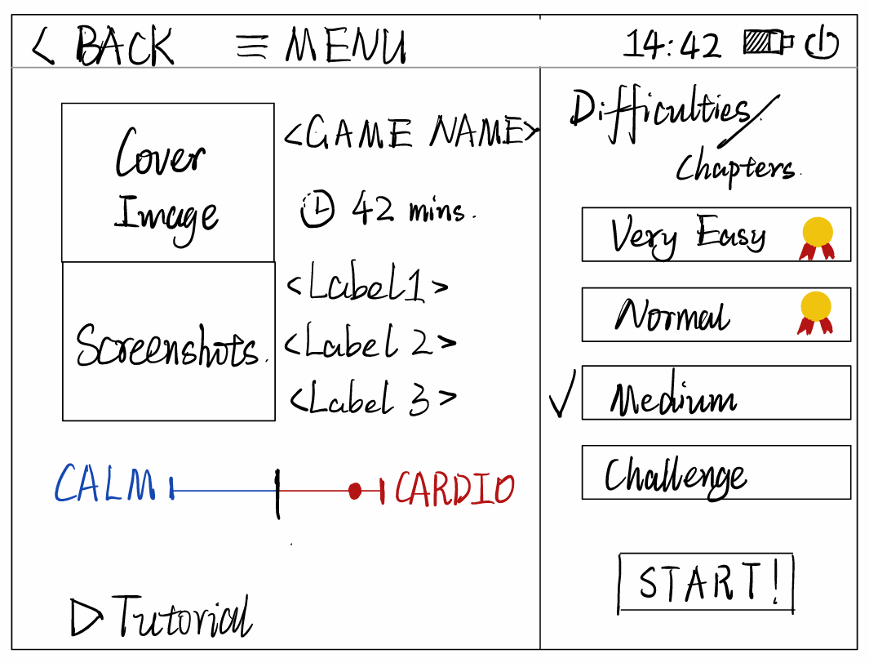
Sketches – Home Menu
Alternative and Iteration
After reviewing user feedback and studying home menu designs of gaming consoles [1], we made alternatives:
Initial
After gathering requirements and personas/scenarios we made sketches of the home menu.
Users asked to keep it streamlined:
More intuitive,
More centralized
1
2
Tap a game icon to jump to its details.
3 – Game selection
User feedback:
Reduce page transitions to simplify operations
Centralize presentation as much as possible
Use more icons and less text for guidance

Slide 5
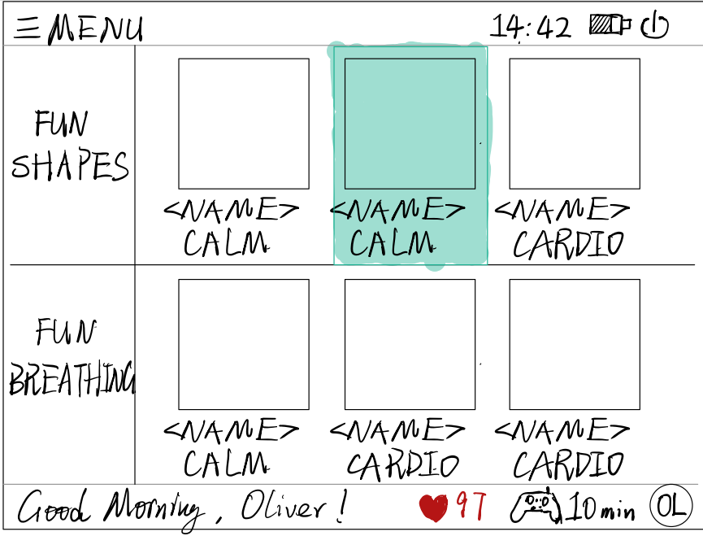
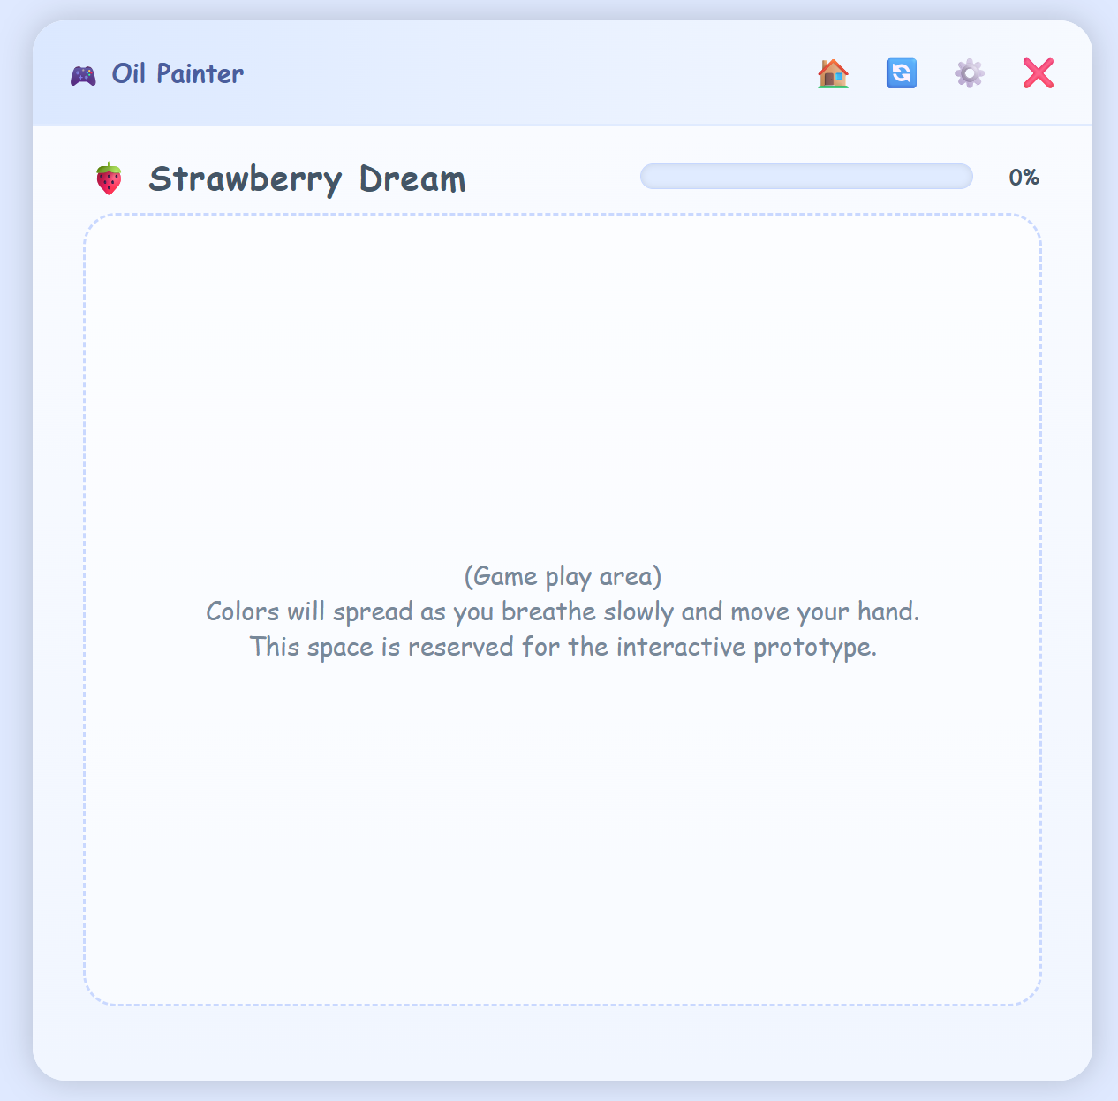
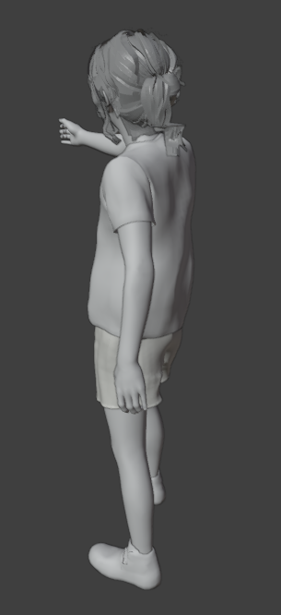
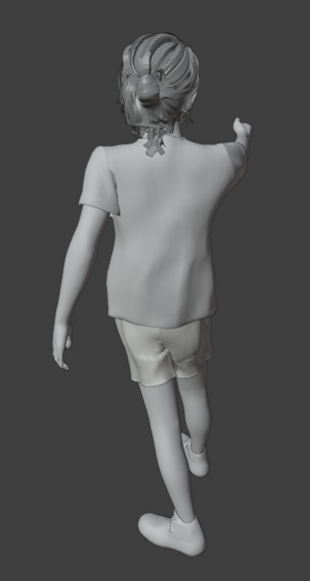
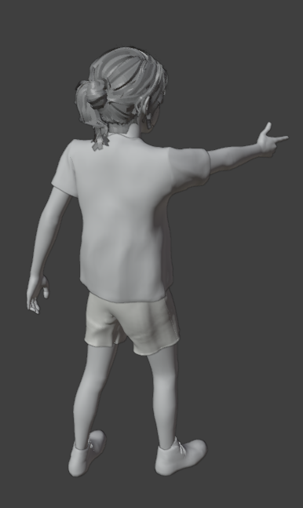
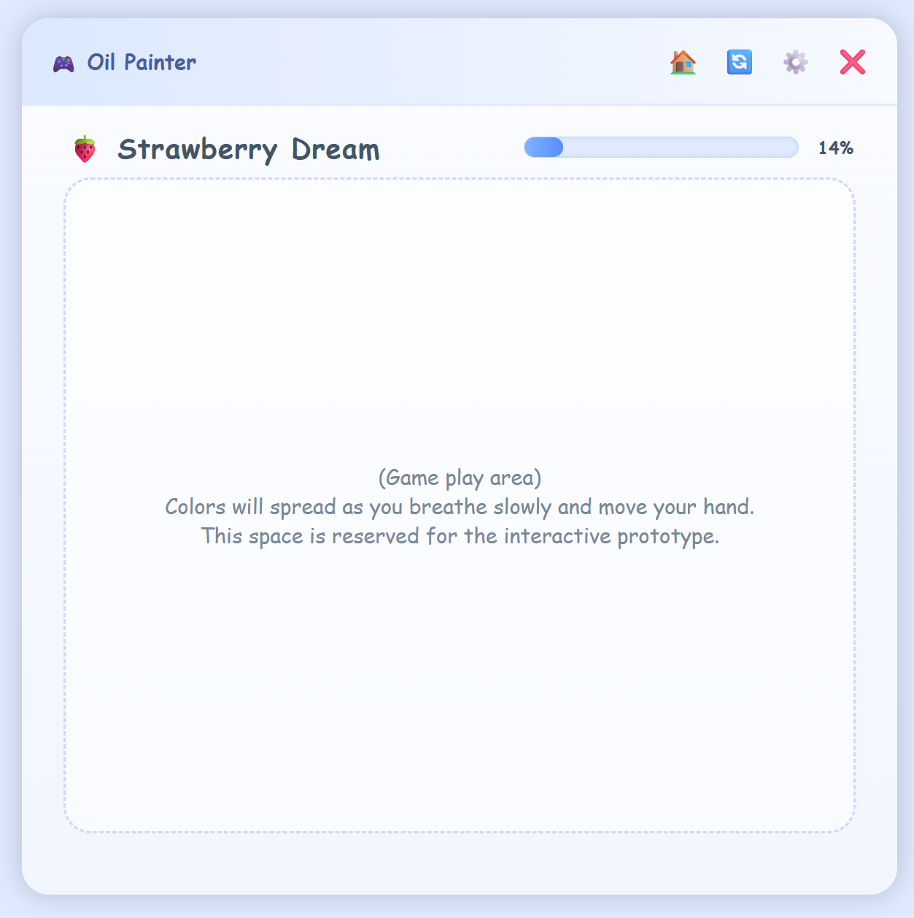
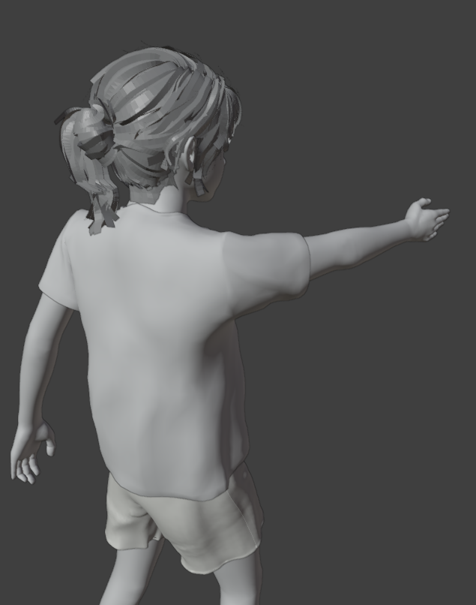
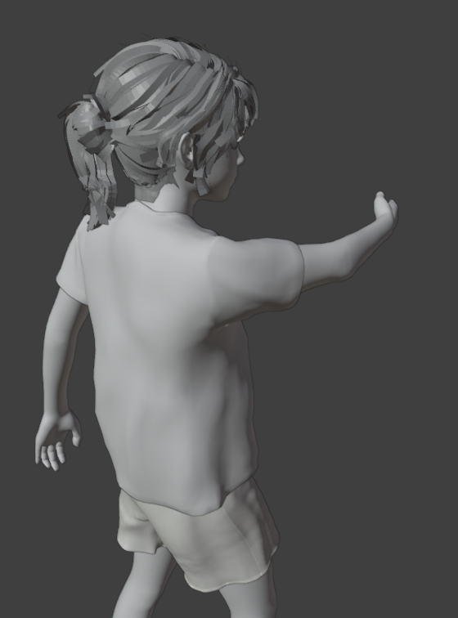
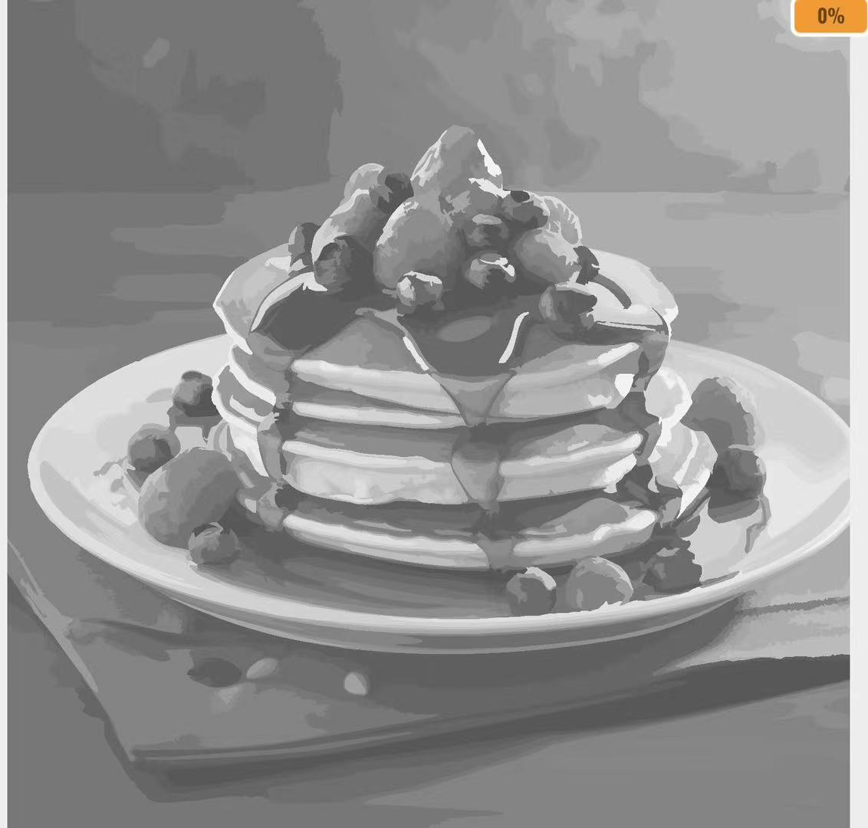
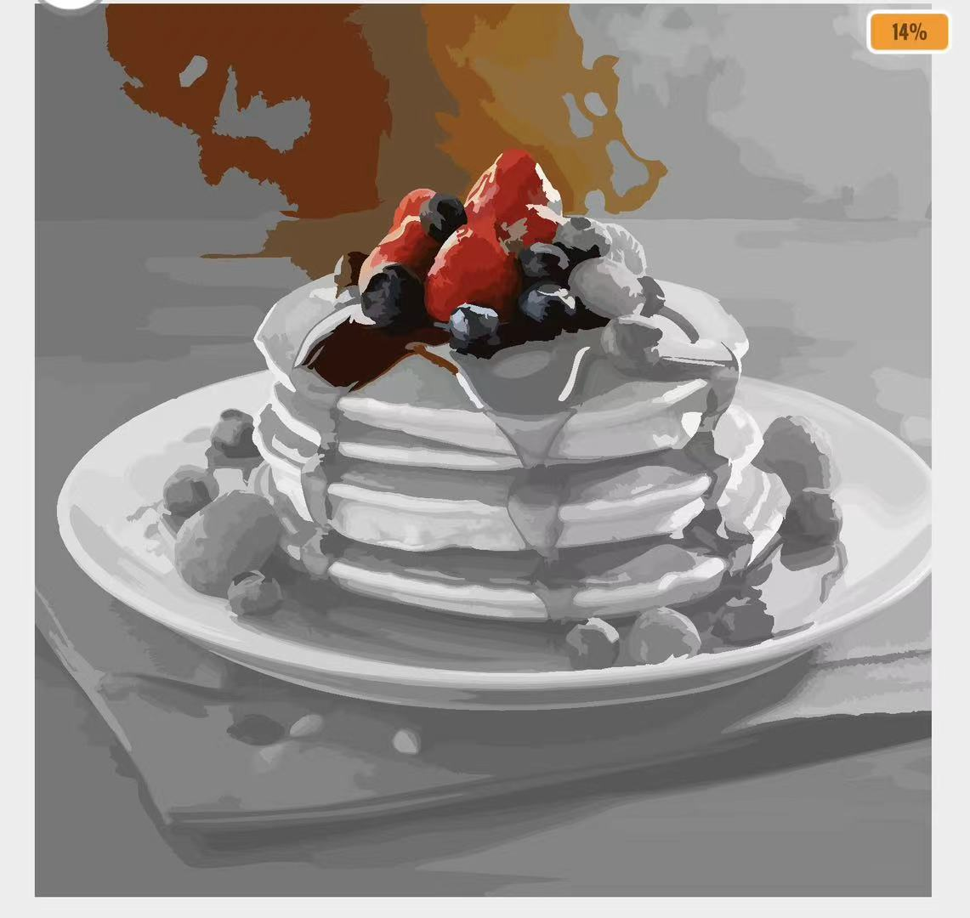
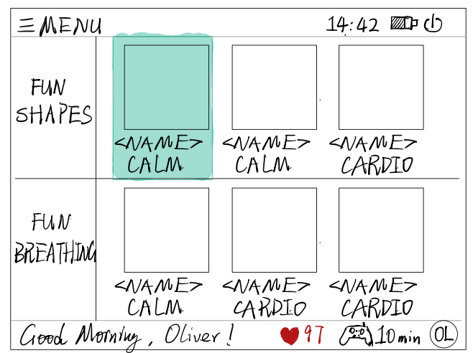
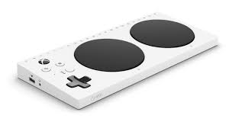
Sketches – Human Computer Interaction
Users suggested:
Swiping model is too complex for children with neurodiversity.
For aiming, the computer finds the angle of a player's finger and computes the position of the cursor.
Our initial interaction method is based on a "swiping" motion:
A swipe to the left shifts the object to the left
A pointing gesture interacts with the object
Iteration:
Use mostly aiming and gesturing.
Keep swiping only for certain games (e.g. Fruit Ninja).
More straightforward,with more options for interaction.
* User's posings mapped in blender using 3D model [2]
Previous page/scene
Previous page/scene
Gesturing
Next page/scene
Aiming
A swipe to the left
Note: For people with paralysis or cerebral palsy, we will use accessible mice or the Xbox Adaptive Controller
Next page/scene
Previous page/scene
Next page/scene

Slide 6
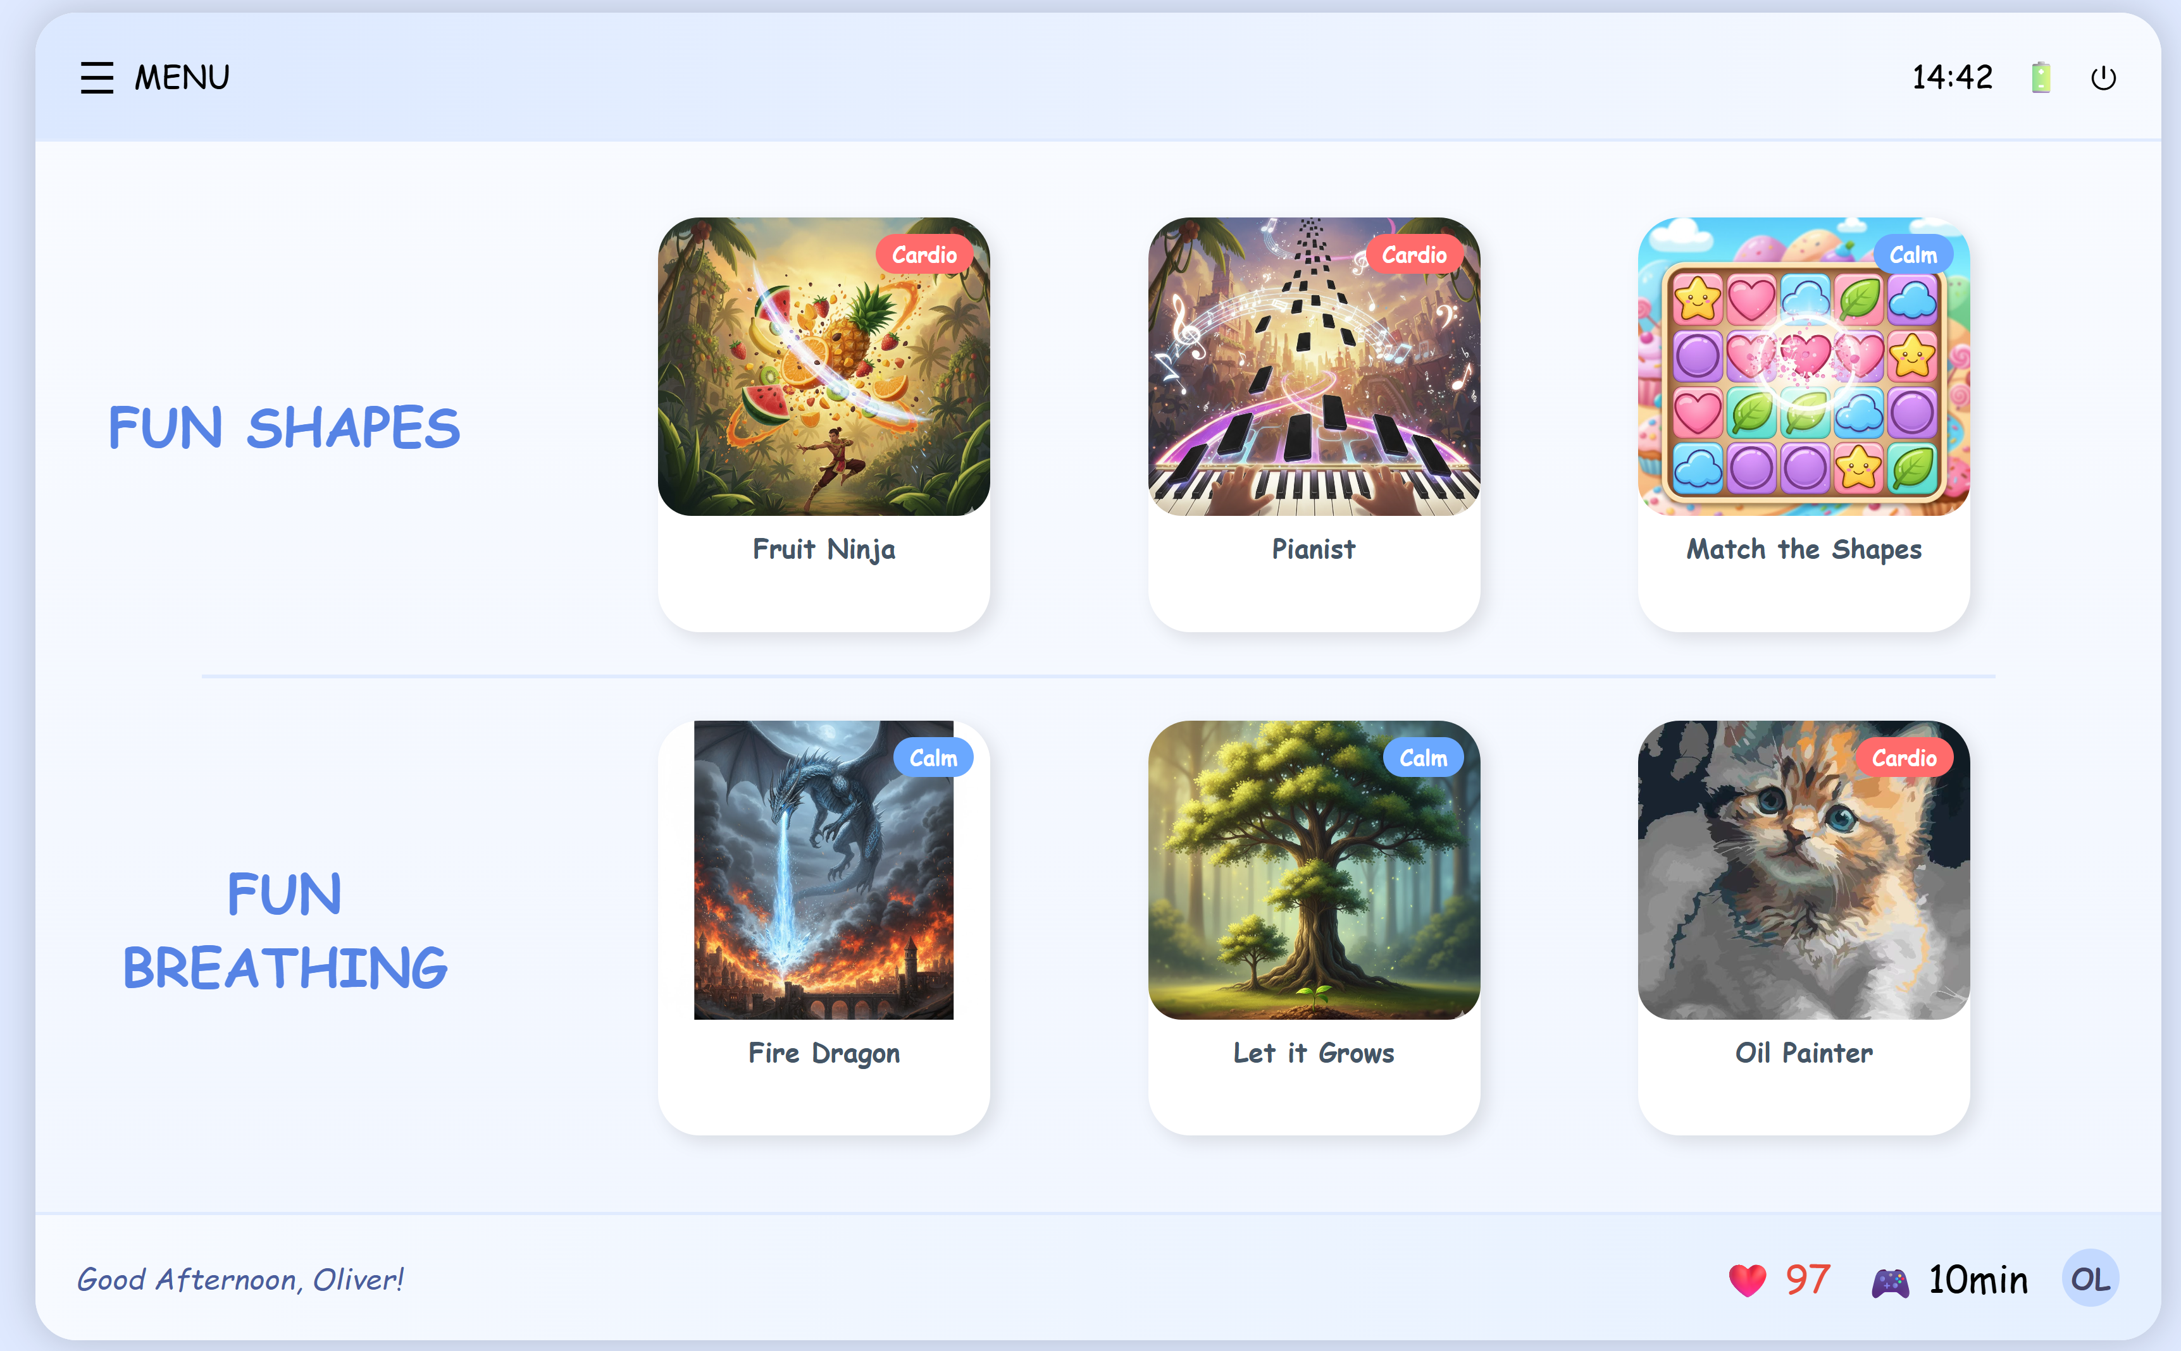
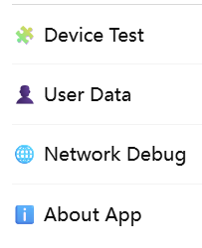
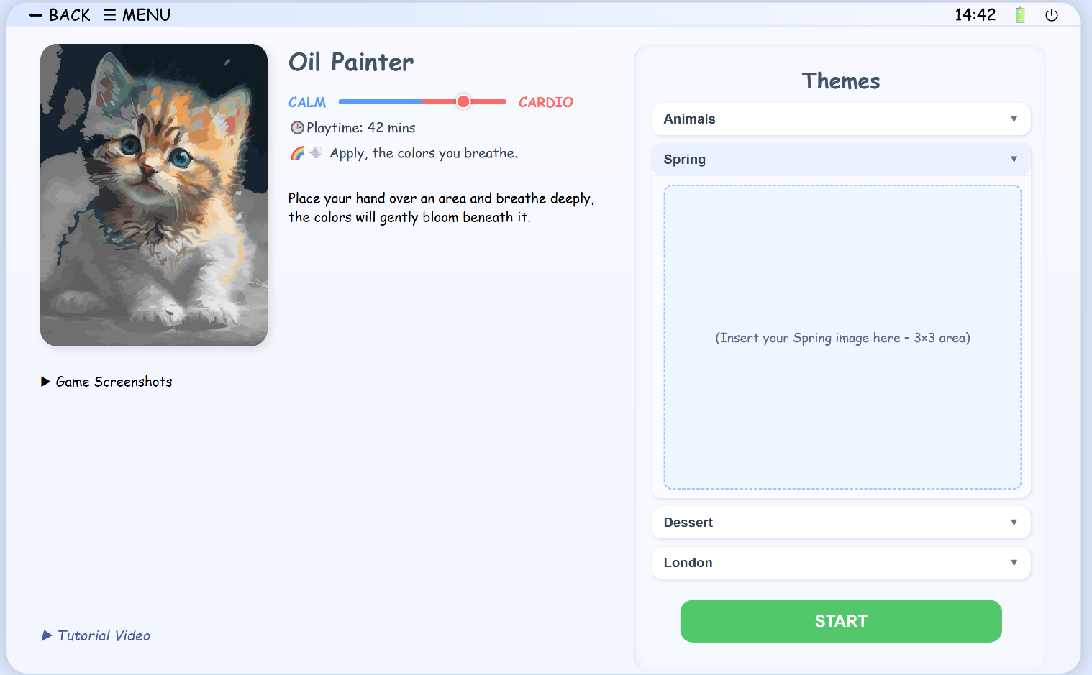
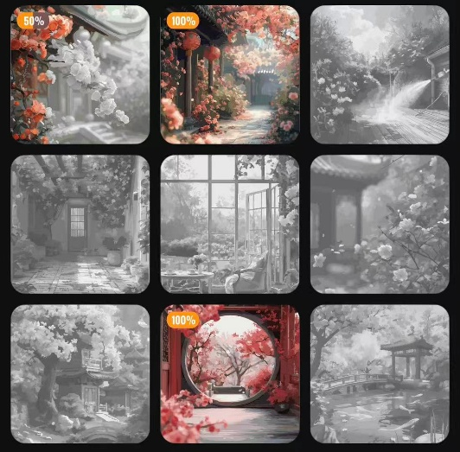
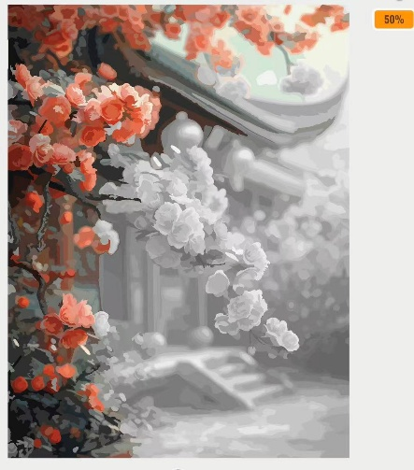
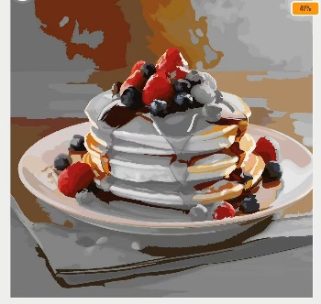
Prototypes – Home Menu
The layout style and operational logic of the home screen is simpler and unified:
Select and click a game
2. In the game details page now. You can:
Browse the game.
Watch the tutorial or demo video
Go back
3. Select theme, select a painting awaiting to color, and start playing (for other games, select a difficult or chapter).

Slide 7
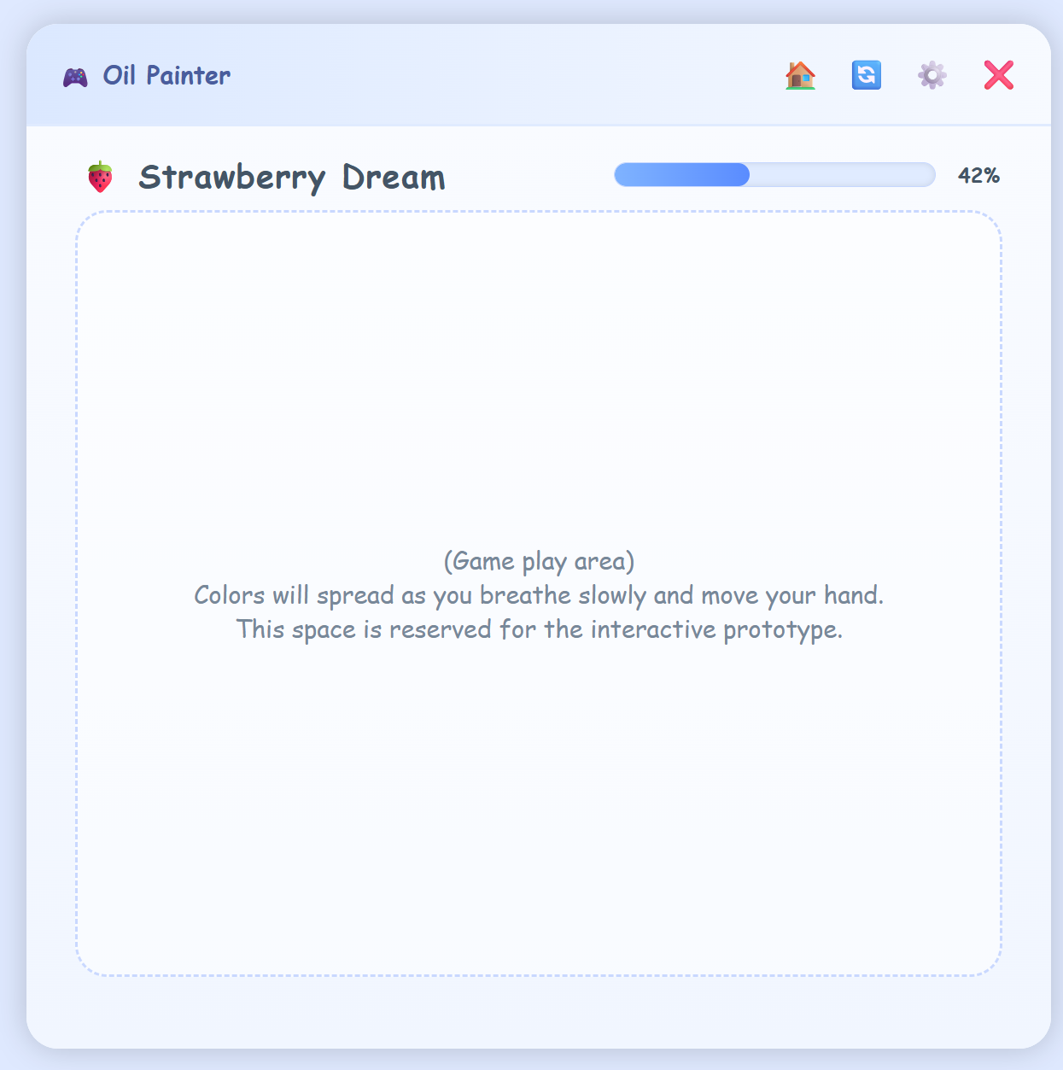
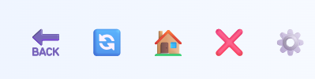
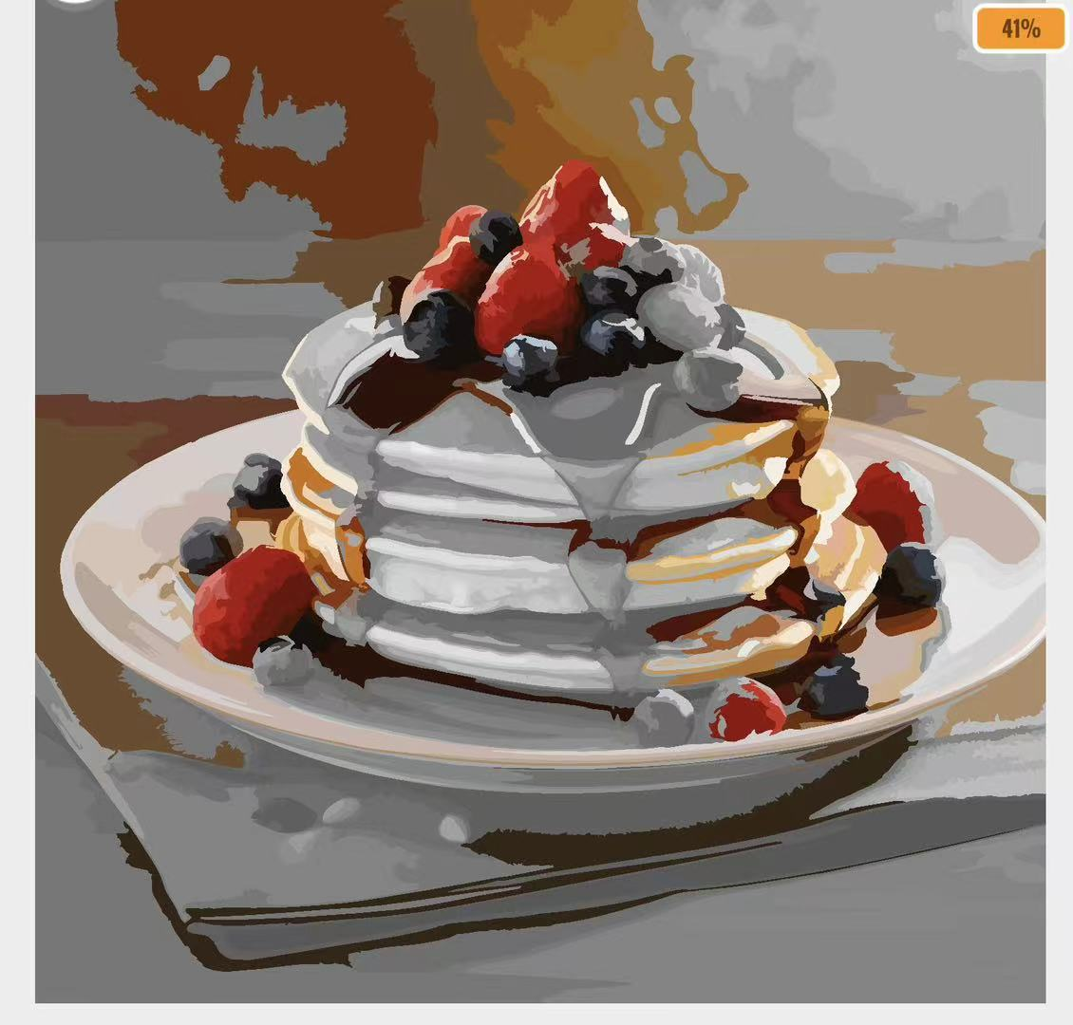
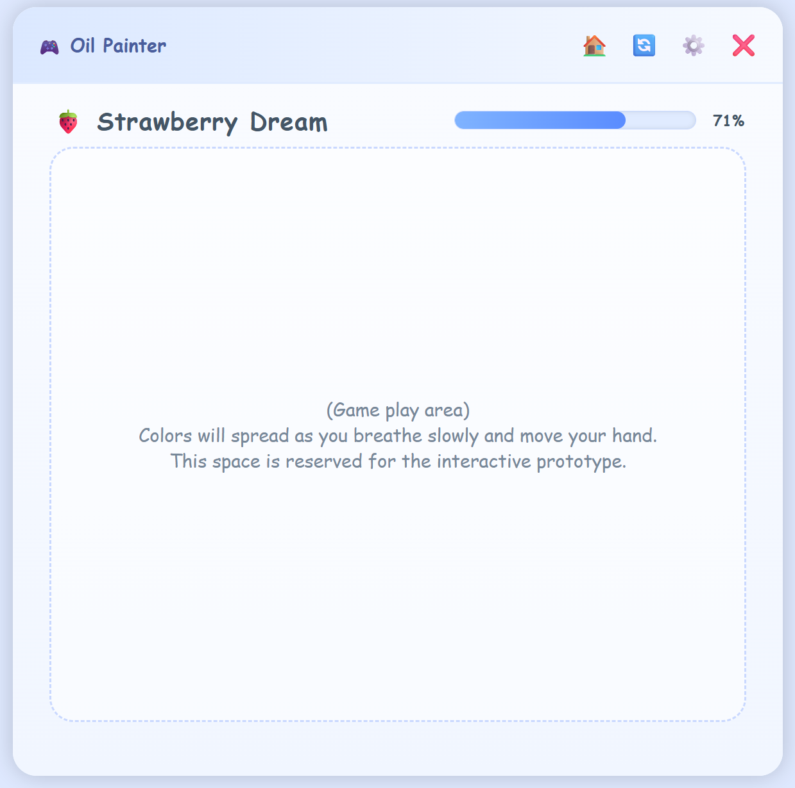
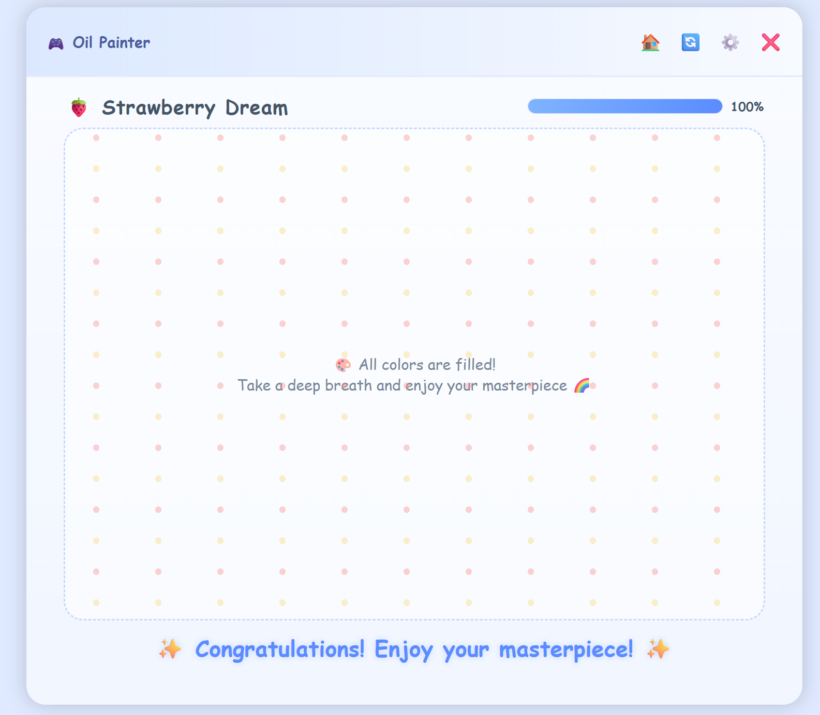
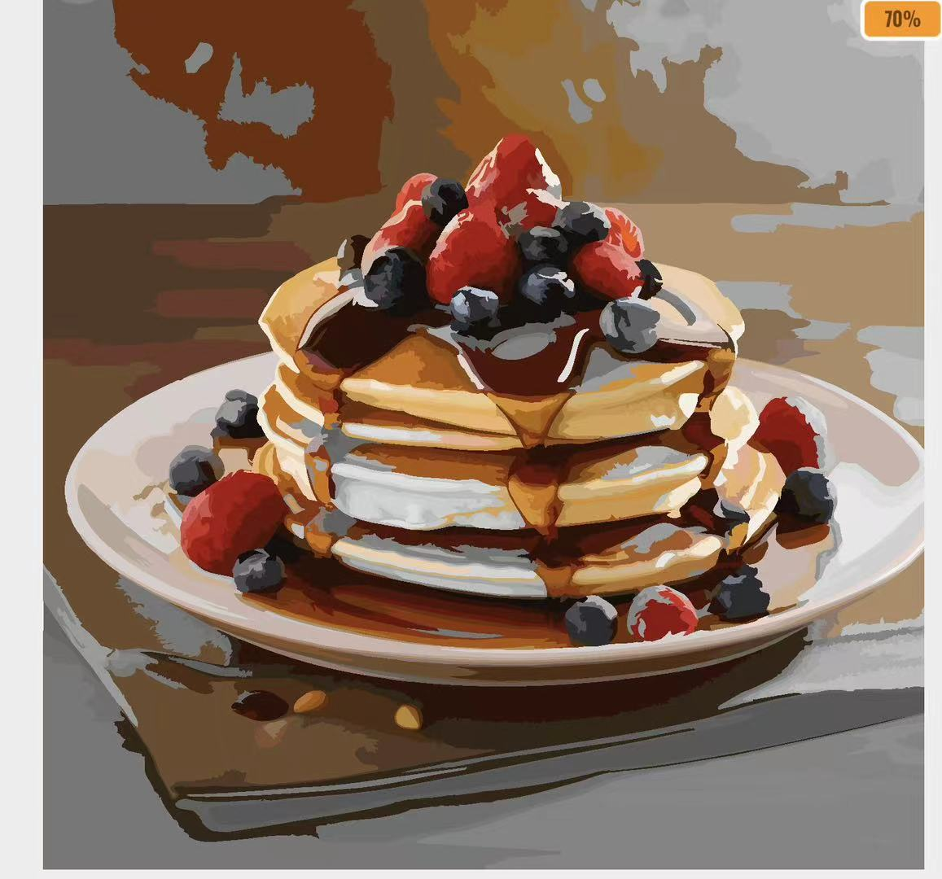
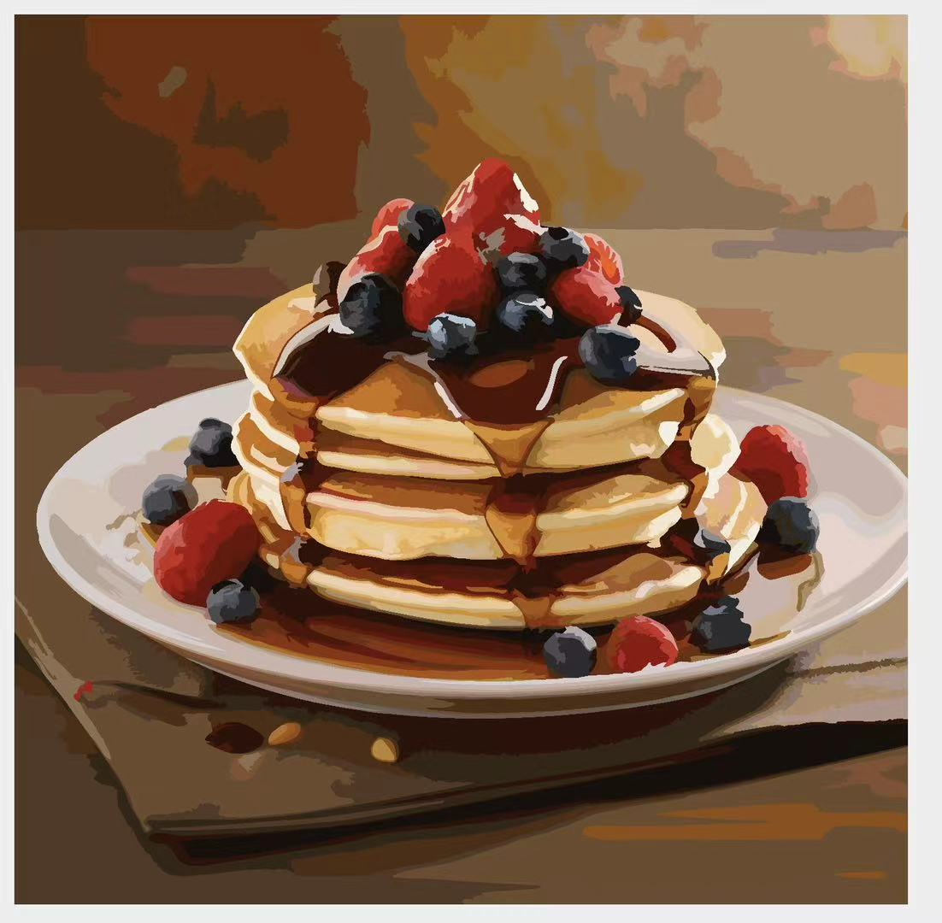
Prototypes – Game
Since we need to develop multiple games with different styles, we will show only one here:
How to play:
1. Place palm over an area of the screen, hold it still.
2. Breathe slowly for 5 seconds.
3. Colours in that area will slowly expand, like a flower blooming.
4. Progress bar rises.
At the beginning, the painting is entirely black and white.
Move palm to other areas and repeat the previous process.
A masterpiece is born!
It can be saved in the device and printed.
Users can move their palm to shade in areas...
...or choose to expand from one spot!
Now you can choose to:
Begin another painting
Replay
Back to play other games
Quit the App
Save
Print

Slide 8
Evaluation of Prototype
After initially completing the prototype, we evaluated it based on 10 Usability Heuristics for User Interface Design (Jakob Nielsen) [3] and incorporated user feedback and suggestions to make improvements.
Heuristic | Problem | Solution | Severity (out of 5)
Visibility of system status/ Match between system and real world | Users need constant feedback on whether their current body movements are being captured properly to ensure smooth gameplay. Additionally, bright colors or sounds should be used to indicate the gaming progress. | <Will be displayed on the next page> | 3
Consistency and standards | As the number of pages and games increases, the layout of screen and icons may become cluttered and inconsistent. | Before development begins, create a set of templates and a documentation guide for each feature’s page. Standardize layout styles, color themes, and the meanings represented by icons. | 1
Help and documentation | To maintain a clean interface within the app, we've used more icons with minimal text explanations. This may cause users to feel confused during operation or unsure how to play these games. | Create detailed page documentation and record tutorial videos for each game. | 2

Slide 9
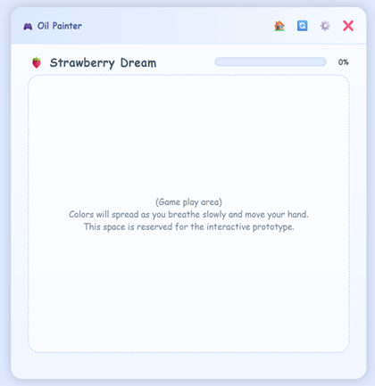

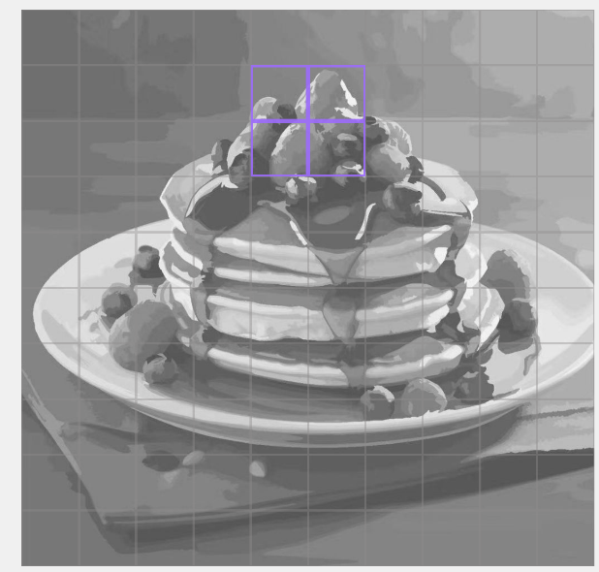
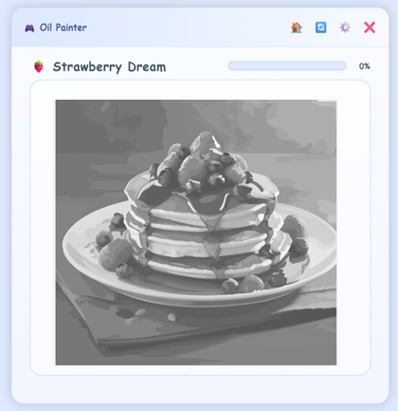
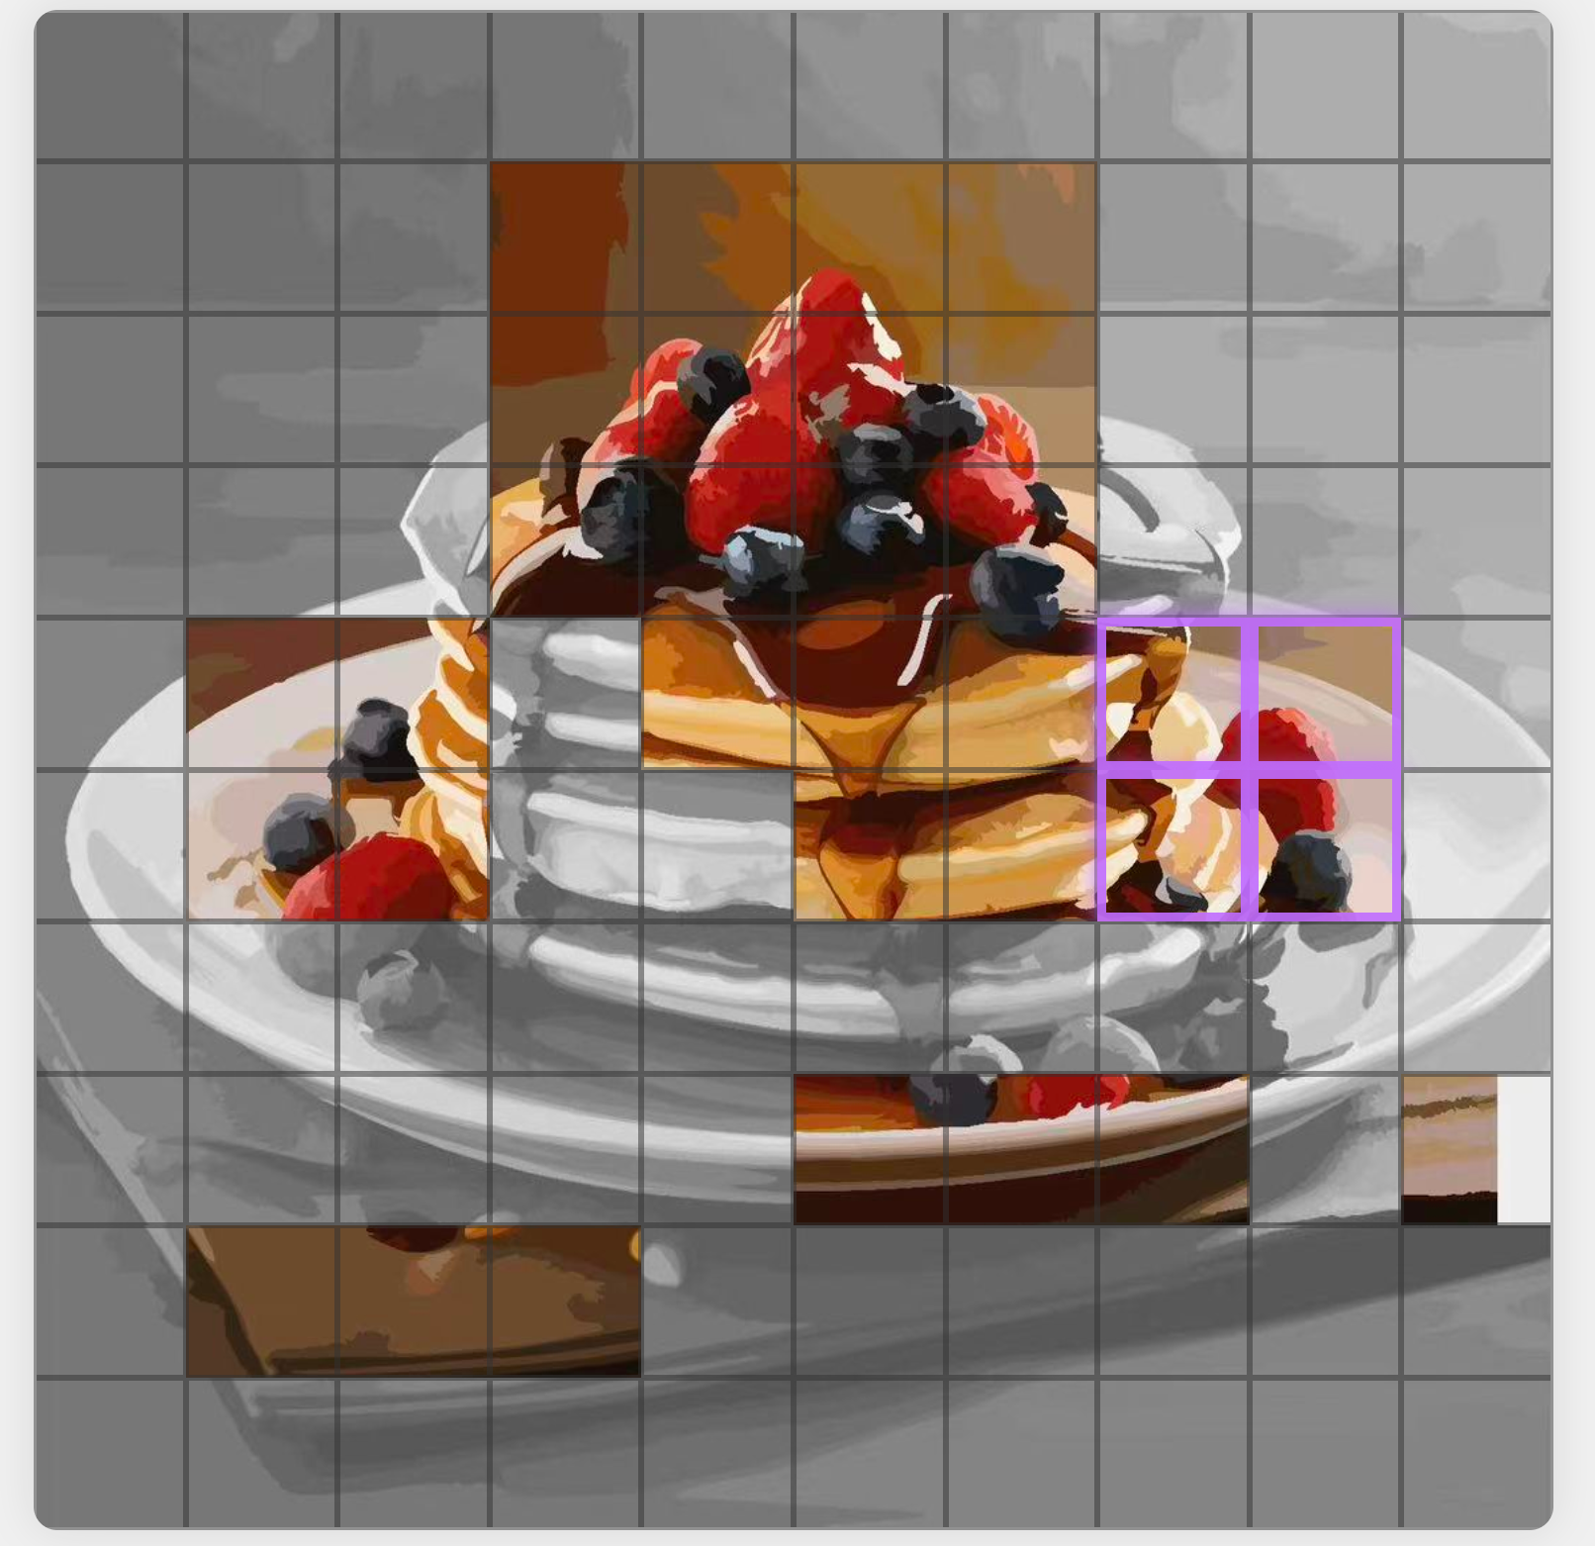

Improved Prototypes
Feedback:
Users suggested aiming was unclear/confusing
Improvement:
Yellow circle represents the area covered by the user's palm
Purple border highlights the section being colored.
This provides clear feedback, to understand progress.
Playing….
Feedback:
"The gaming process should be modifiable."
Improvement:
We divide a painting into a grid and color them as individual units.
This makes the contrast between colored and uncolored areas more distinct.
Each square requires X seconds of deep breaths to fully color. The teacher can set X from 1 to 10s.
This makes each session more manageable, allowing teachers to plan activity durations.
Paused
We used Wizard of Oz method to test prototypes and get feedback.
Note: No pictures of tests are shown due to no consent from testers.

Slide 10
References
Nintendo, “Nintendo Switch HOME Menu Overview,” Nintendo Support. [Online]. Available: Nintendo Switch HOME Menu Overview | Nintendo Support [Accessed: Nov. 4, 2025].
Baron Khaloui, "Free Rigged 3D Girl Character Game Animation Ready." *TurboSquid*, n.d., https://www.turbosquid.com/3d-models/free-rigged-3d-girl-character-game-animation-ready-2364941 [Accessed 2 Nov. 2025].
Jakob. Nielsen, "10 Usability Heuristics for User Interface Design," Nielsen Norman Group, Jan. 1, 1995. [Online]. Available: https://www.nngroup.com/articles/ten-usability-heuristics/. [Accessed: Nov. 4, 2025].

